Slide 1
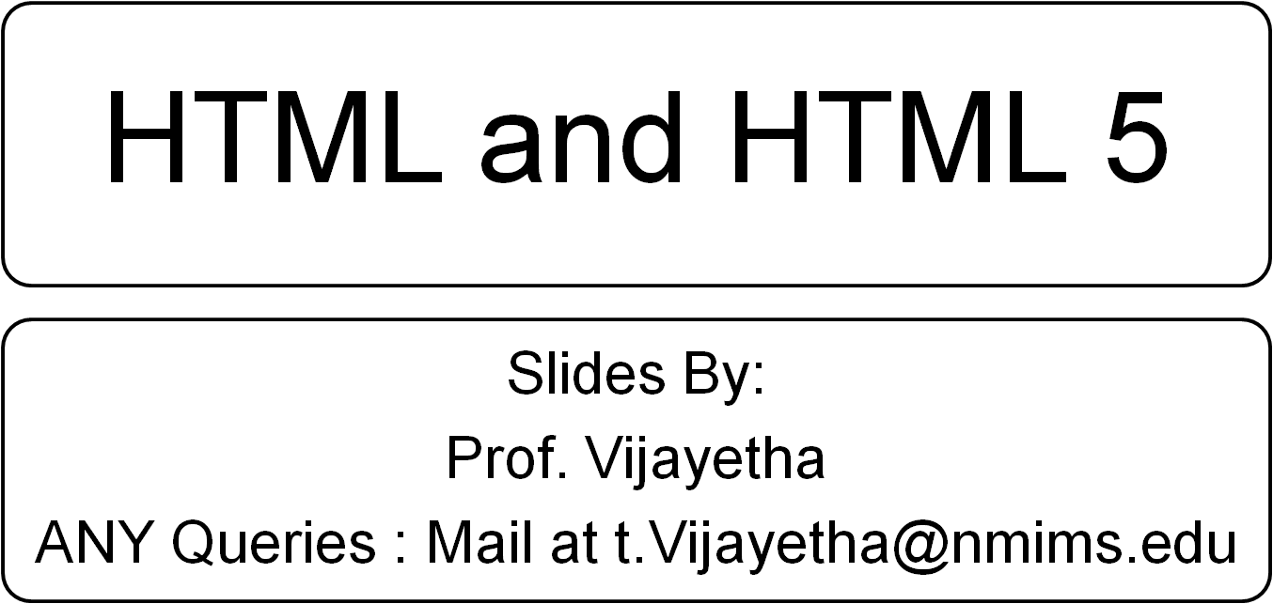

Slide 2
Website Creation
My take on a good website:
“A website with no traffic is worthless”
“A website should be designed with good search engine optimization”
“Along with end users there are search bots and web crawlers too that visit your website”

Slide 3
What is HTML?
HTML is how two computers speak to each other over the internet.
Web sites are what they say.
HTML is "spoken" by two computers:
1. Client
The client is used by the person surfing the net, such as the computer you are looking at right now.
2. Server
A server stores and distributes websites over the net. I have a server where I store this web site.
HTML: Hyper Text MARKUP Language

Slide 4
Template
At the very top of the page you will see the doctype declaration:
<!DOCTYPE html>
HTML5 has a grammar and a vocabulary.
Grammar says it should be written at the top of the web page
Vocabulary says this page is written in HTML5
This declaration was messy till html4

Slide 5
The html tag
  Tags are containers. The html tag indicates that everything between <html> and </html> is code that conforms to the standards of the type of HTML
  Inside html tag, we have head and body tag
  <html>
  <head>
  </head>
  <body>
  </body>
  </html>

Slide 6
The head tag
Inside head tag we have title tag
Web sites that read well to spiders are most likely to appear high in search engine results.
The single most important thing you can do for SEO is write a good title tag
Ex
<title>HTML Tutorial</title>

Slide 7
Meta tags also go in the head tag
<meta charset="utf-8">
<meta name="description" content=".">.

Slide 8
The body tag
The body tag contains the code that generates what is seen in a browser.
Every tag has attributes and attribute value that specify the properties to be applied on the tag
Ex:
<body bgcolor=“red”>

Slide 9
The heading tags
<h1>h1 tag</h1>
<h2>h2 tag</h2>
<h3>h3 tag</h3>
<h4>h4 tag</h4>
<h5>h5 tag</h5>
<h6>h6 tag</h6>
Google likes them
But dont do spamdexing

Slide 10
The paragraph tag
The <p> tag is probably the handiest and most commonly used of all tags.
<!DOCTYPE html>
<html lang="en">
<head>
<meta charset="utf-8">
<title>My first webpage</title>
</head>
<body>
<p>My first webpage</p>
</body>
</html>

Slide 11
ul and ol list tags
ul creates unordered list
Ol creates ordered list
Li indicates list item
Lists can be "nested" or put inside one another.
<ul> <li>apples</li> <li>bananas</li> </ul> | <ol> <li>……</li> <li>……</li> </ol>

Slide 12
The a or the anchor tag
With a we create hyper links to other web documents or divisions within the same page
<a href="https://www.google.com">click here</a>
Sometimes we see
target="_blank“
This implies the new web document to be opened in new tab

Slide 13
img tag
Img tag is a container. It holds image
Syntax
<img src=“sample.jpeg” alt=“this is flower image” width=“20” height=“20”>

Slide 14
The table tag
<table border=“1”>
<tr>
<td>Row 1 - Col 1</td>
<td>Row 1 - Col 2</td>
</tr>
<tr>
<td>Row 2 - Col 1</td>
<td>Row 2 - Col 2</td>
</tr>
</table>

Slide 15
We can use properties like cellspacing, cellpadding, rowspan,colspan
Ex
<table cellpadding="5" cellspacing="5" border="1">
<tr>
<td>Row 2 - Col 1</td>
<td colspan="2" rowspan="3">Row 2, 3 & 4 - Col 2 & 3</td>
</tr>

Slide 16
div tag
Div is a tag.
The <div> tag, as W3C puts it, is a "generic container for flow content that by itself does not represent anything“ unlike other tags of html
Basically for content layout

Slide 17
Ex:
<div class="outer-div"> This div tag <div class="inner-div"> contains this div tag. </div> </div> | <style> .outer-div { } .inner-div { } </style>

Slide 18
Attributes
<body background="sample.jpeg">
<body bgcolor=“red”>
<p align=“center”>
Deprecated tags moved to css
<font>
<center>

Slide 19

Introduction to
HTML5

Slide 20
History of HTML
1991
HTML first published
1995
HTML 2.0
After HTML 4.01 was released, focus shifted to XHTML and its stricter standards.
1997
HTML 3.2
1999
HTML 4.01
XHTML 2.0 had even stricter standards than 1.0, rejecting web pages that did not comply. It fell out of favor gradually and was abandoned completely in 2009.
2000
XHTML 1.0
2002 -2009
HTML5 is much more tolerant and can handle markup from all the prior versions.
XHTML 2.0
HTML5
Though HTML5 was published officially in 2012, it has been in development since 2004.
2012

Slide 21
What is HTML5?
HTML5 is the newest version of HTML, only recently gaining partial support by the makers of web browsers.
It incorporates all features from earlier versions of HTML, including the stricter XHTML.
It adds a diverse set of new tools for the web developer to use.
It is still a work in progress. No browsers have full HTML5 support. It will be many years –- before being fully defined and supported.

Slide 22
Goals of HTML5
Support all existing web pages. With HTML5, there is no requirement to go back and revise older websites.
Reduce the need for external plugins and scripts to show website content.
Improve the semantic definition (i.e. meaning and purpose) of page elements.
Make the rendering of web content universal and independent of the device being used.
Handle web documents errors in a better and more consistent fashion.

Slide 23
New Elements in HTML5
<article>
<aside>
<audio>
<canvas>
<datalist>
<figure>
<figcaption>
<footer>
<header>
<hgroup>
<mark>
<nav>
<progress>
<section>
<source>
<svg>
<time>
<video>
These are just some of the new elements introduced in HTML5. We will be exploring each of these during this course.

Slide 24
Other New Features in HTML5
Built-in audio and video support (without plugins)
Enhanced form controls and attributes
The Canvas (a way to draw directly on a web page)
Drag and Drop functionality
Support for CSS3 (the newer and more powerful version of CSS)
More advanced features for web developers, such as data storage and offline applications.

Slide 25
First Look at HTML5
Remember the DOCTYPE declaration from XHTML?
<!DOCTYPE html PUBLIC "-//W3C//DTD XHTML 1.0 Transitional//EN"
"http://www.w3.org/TR/xhtml1/DTD/xhtml1-transitional.dtd">
In HTML5, there is just one possible DOCTYPE declaration and it is simpler:
<!DOCTYPE html>
Just 15 characters!
The DOCTYPE tells the browser which type and version of document to expect. This should be the last time the DOCTYPE is ever changed. From now on, all future versions of HTML will use this same simplified declaration.

Slide 26
The <html> Element
This is what the <html> element looked like in XHTML:
<html xmlns="http://www.w3.org/1999/xhtml" xml:lang="en" lang="en">
Again, HTML5 simplifies this line:
<html lang="en">
The lang attribute in the <html> element declares which language the page content is in. Though not strictly required, it should always be specified, as it can assist search engines and screen readers.
Each of the world’s major languages has a two-character code, e.g. Spanish = "es", French = "fr", German = "de", Chinese = "zh", Arabic = "ar".

Slide 27
The <head> Section
Here is a typical XHTML <head> section:
<head>
<meta http-equiv="Content-type" content="text/html; charset=UTF-8" />
<title>My First XHTML Page</title>
<link rel="stylesheet" type="text/css" href="style.css" />
</head>
And the HTML5 version:
<head>
<meta charset="utf-8">
<title>My First HTML5 Page</title>
<link rel="stylesheet" href="style.css">
</head>
Notice the simplified character set declaration, the shorter CSS stylesheet link text, and the removal of the trailing slashes for these two lines.

Slide 28
Basic HTML5 Web Page
Putting the prior sections together, and now adding the <body> section and closing tags, we have our first complete web page in HTML5:
<!DOCTYPE html>
<html lang="en">
<head>
<meta charset="utf-8">
<title>My First HTML5 Page</title>
<link rel="stylesheet" href="style.css">
</head>
<body>
<p>HTML5 is fun!</p>
</body>
</html>
Let's open this page in a web browser to see how it looks…

Slide 29
Removed Elements in HTML5
Removed Element | Use Instead
<acronym> | <abbr>
<applet> | <object>
<basefont> | CSS
<big> | CSS
<center> | CSS
<dir> | <ul>
<font> | CSS
<frame>
<frameset>
<noframes>
<strike> | CSS, <s>, or <del>
<tt> | CSS

Slide 30
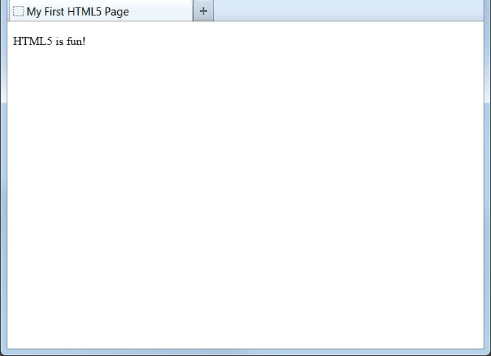
Viewing the HTML5 Web Page
Even though we used HTML5, the page looks exactly the same in a web browser as it would in XHTML. Without looking at the source code, web visitors will not know which version of HTML the page was created with.

Slide 31
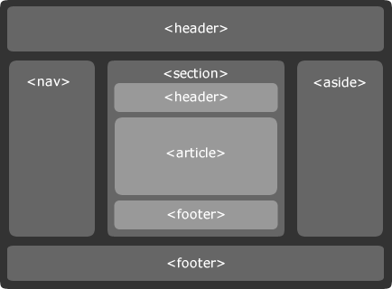

Slide 32
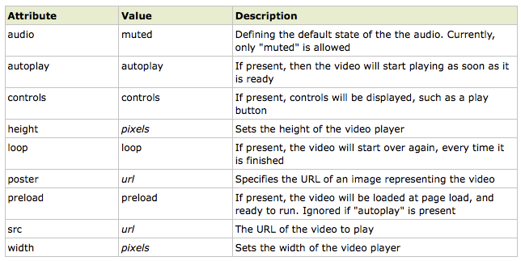
<video src="movie.ogg" width="320" height="240" controls="controls">
</video>

Slide 33
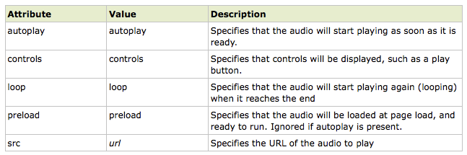
<audio src="song.ogg" controls="controls">
</audio>

Slide 34
The HTML5 canvas element uses JavaScript to draw graphics on a web page.
A canvas is a rectangular area, and you control every pixel of it.
The canvas element has several methods for drawing paths, boxes, circles, characters, and adding images.
<canvas id="myCanvas" width="200" height="100"></canvas>
The canvas element has no drawing abilities of its own. All drawing must be done inside a JavaScript:
<script type="text/javascript">
var c=document.getElementById("myCanvas");
var cxt=c.getContext("2d");
cxt.fillStyle="#FF0000";
cxt.fillRect(0,0,150,75);
</script>

Slide 35
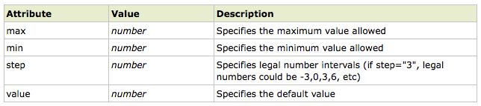
HTML5 has several new input types for forms.
> email
> url
> number
> range
> date pickers (date, month, week, time,
datetime, datetime-local)‏
> search
> color
Examples:
E-mail: <input type="email" name="user_email" />
<input type="number" name="points" min="1" max="10" />

Slide 36
<input type="range" name="points" min="1" max="10" />
HTML5 has several new input types for selecting date and time:
> date - Selects date, month and year
> month - Selects month and year
> week - Selects week and year
> time - Selects time (hour and minute)‏
> datetime - Selects time, date, month and year
> datetime-local - Selects time, date, month and
year (local time)‏
Color: <input type="color" name="user_color" />

Slide 37
HTML5 has several new elements and attributes for forms.
> datalist
> keygen
> output
The datalist element specifies a list of options for an input field. The list is created with option elements inside the datalist.
The purpose of the keygen element is to provide a secure way to authenticate users.
The output element is used for different types of output, like calculations or script output:

